Slide 1
Spring 2021 MIS 637 WS1 - Data Analytics & Machine Learning
Coffee Beans Variants Recommendation Using Clustering
Completed By: Mihir Kadam
mkadam3@stevens.edu
Prof. M. Daneshmand

Slide 2
Contents
Problem Statement and Business Understanding
Data representation
Data Understanding
Data Preparation
Data Normalization
Algorithm Used
Software Package Used
Determination of Number of Clusters
Execution and Analysis
Conclusion
References

Slide 3
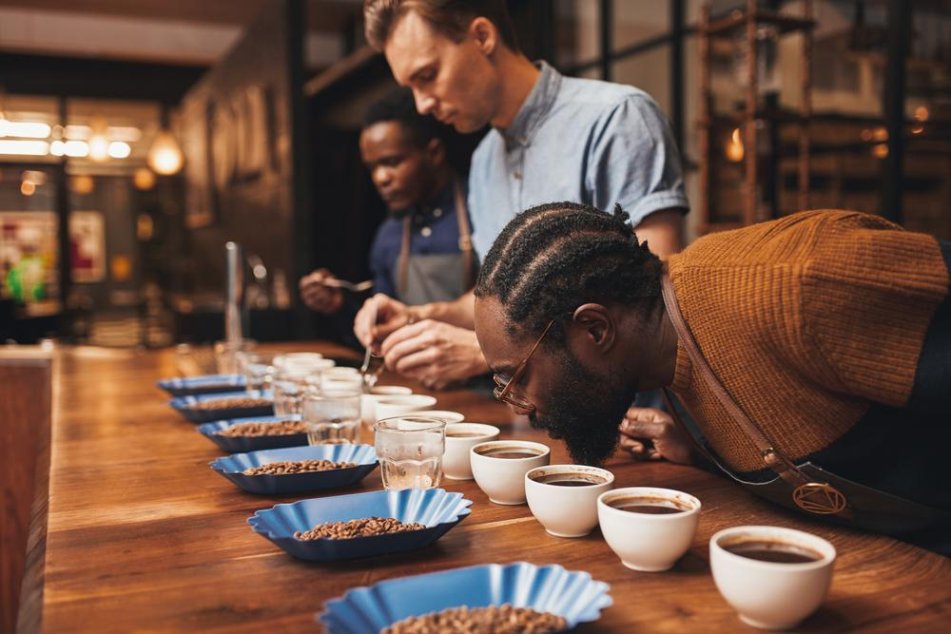
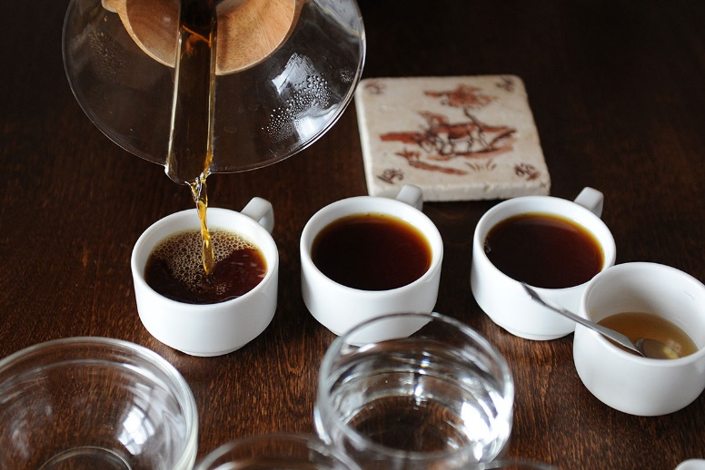
Problem Statement
Coffee connoisseurs are always very particular
about their coffee, especially the bean that has
been used.
These connoisseurs also like to brew their
own coffee every morning with the coffee
bean that they have selected very particularly.
They also spend time researching their coffee.

Slide 4
Clustering of different variants of Coffee beans
By clustering different coffee bean variants together, we can use this information for targeted marketing. If a customer buys a variant, other similar variants can be recommended to them.
In some cases, variants from completely different clusters can also be recommended if the customer is looking for a different taste.
Since connoisseurs also like to mix-match their beans, two beans from completely different clusters can also be recommended for a blend.

Slide 5
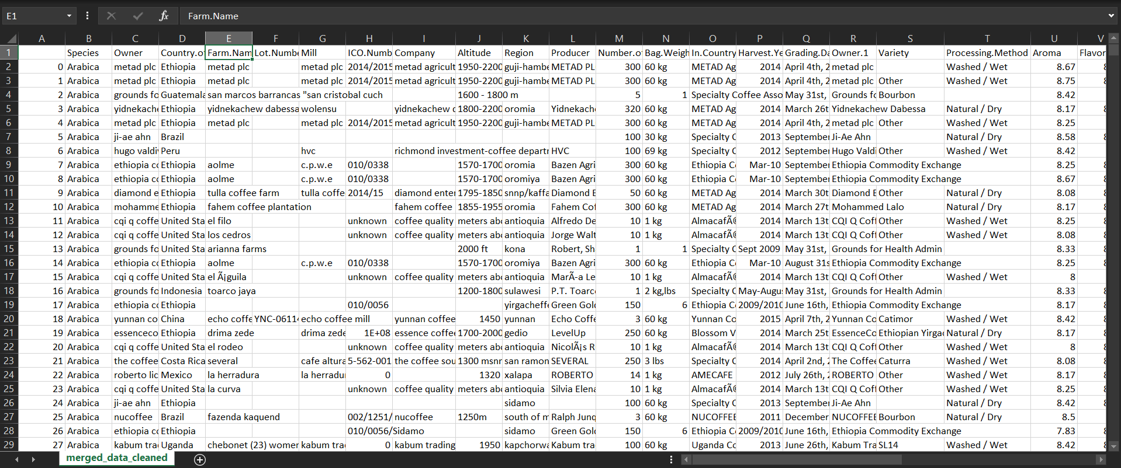
Data Representation

Slide 6
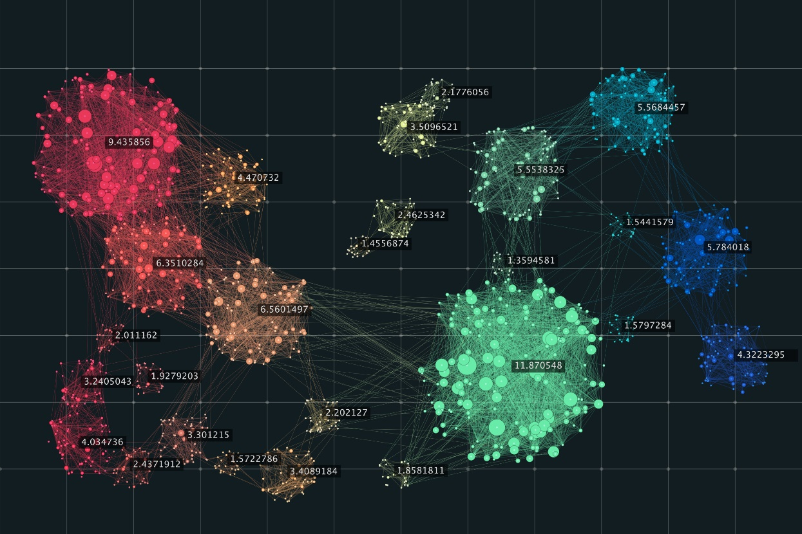
Data Representation (Cont’d)
The extracted data contains 44 columns, all containing different information about the coffee bean such as owner, country, company, farm name, etc.
Some of the data is numeric while some isn’t as visible in the previous slide. Therefore, data standardization will be performed. Also, normalization will be performed.
Out of this, a few relevant attributes will be used for the clustering job.

Slide 7
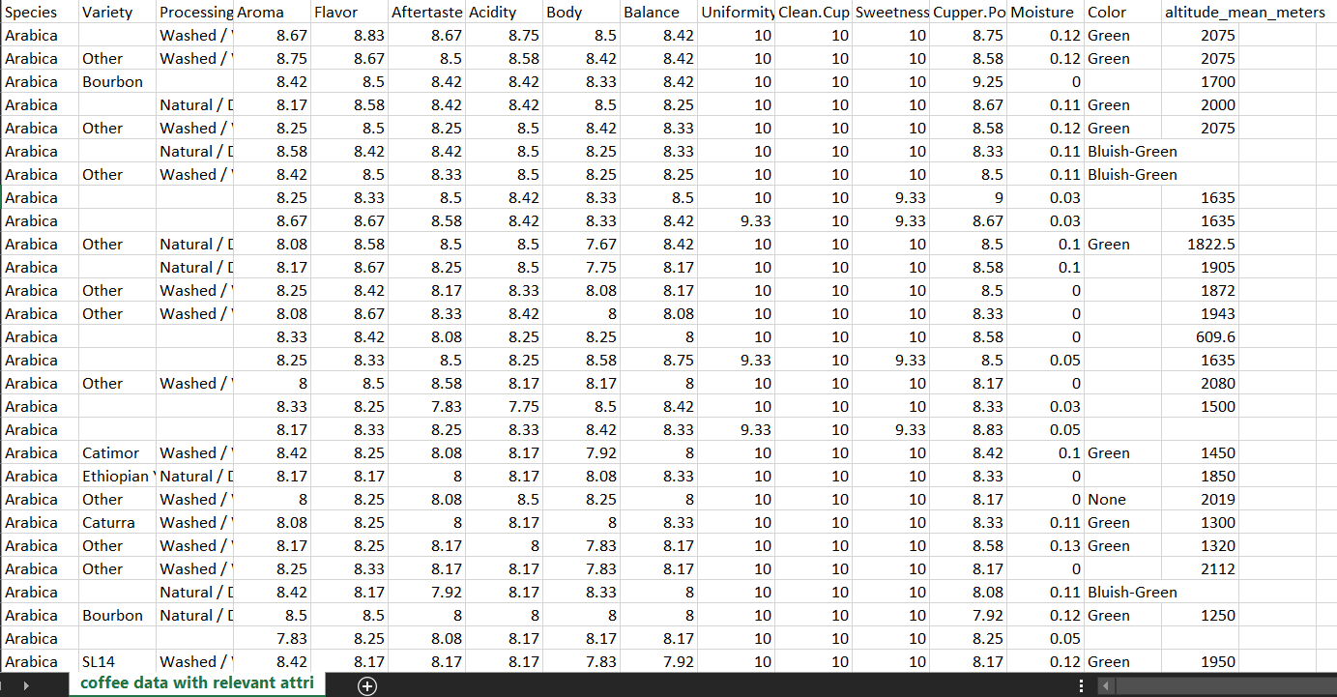
Data Understanding
The data sources contains 44 attributes for 732 different coffee beans.
Out of these 44 attributes, we select the following relevant attributes:
Species, Variety, Processing Method, Aroma, Flavor, Aftertaste, Acidity, Body, Balance, Uniformity, Clean Cup, Sweetness, Cupper Points, Moisture, Color, altitude mean meters.

Slide 8
Data Preparation
We prepare the data by first converting the non-numeric data into numeric. We do this by numbering the unique non-numeric data from 0 to x, where x is the number of unique records in each column
Relevant attributes with numeric and non-numeric data

Slide 9
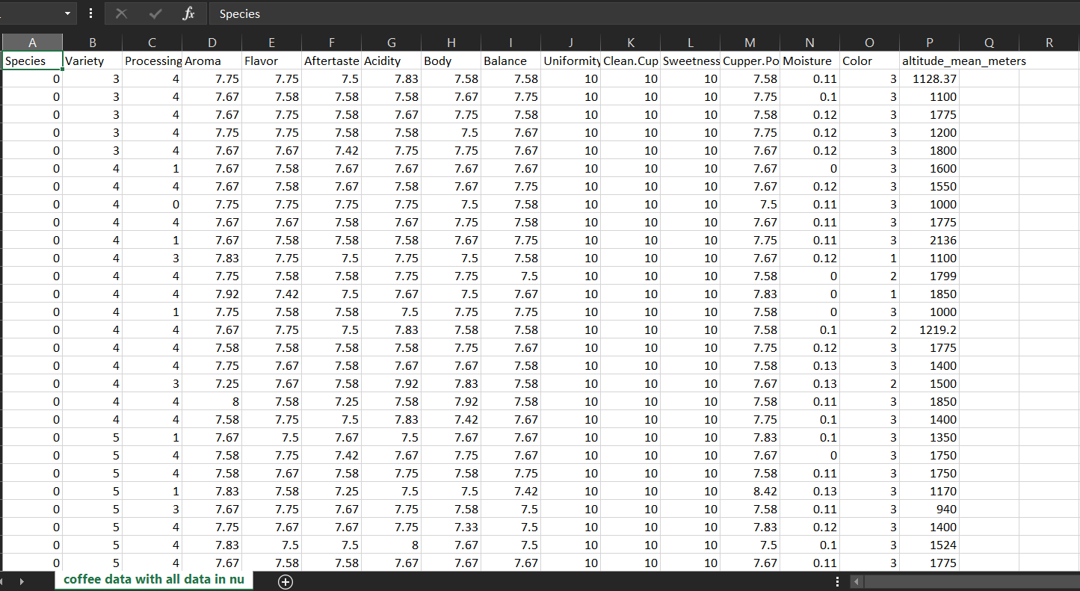
Data Preparation (Cont’d)
After successful transformation, the data looks like this:
Relevant attributes with only numeric data

Slide 10
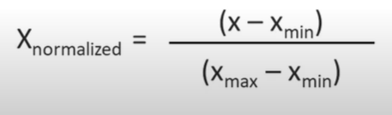
Data Normalization
For the algorithm to work effectively and get accurate results, we normalize the data.
Since the values of attributes range from a maximum of 2 in one column, to a maximum of 190164 in another, we normalize the data to bring the range down to 0 to 1.
We normalize using the following formula:
Here, X is the value in the cell which we are normalizing.
Xmin and Xmax are minimum and maximum values in the selected column, respectively.
The data looks like following after normalization:
[1]

Slide 11
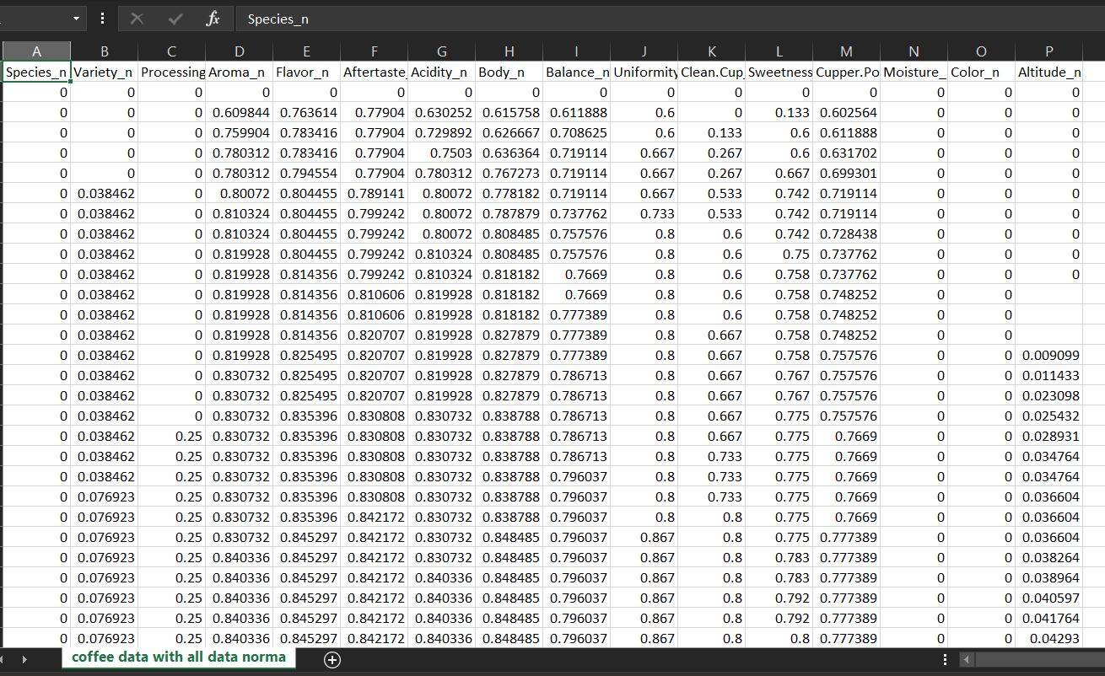
Data Normalization (Cont’d)

Slide 12
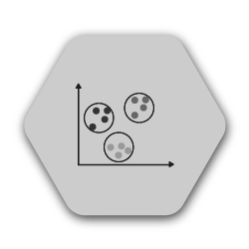
Data Normalization (Cont’d)
As it is visible, all data is now in numeric and ranges from 0 to 1.
Missing values are dealt with by weka (the software package to be used).
The only outliers present were in the altitude column. The values were 190164 meters, 110000 meters, and 11000 meters (before normalization). We delete these values since the altitude of the highest peak in the world (Mt. Everest) is 8848.9 meters.
At this point, our data is ready for the clustering job.

Slide 13
Algorithm
We will be using K-means for the clustering job.
K-means clustering is a method of vector quantization, that aims to partition n observations into k clusters in which each observation belongs to the cluster with the nearest mean (cluster centers or cluster centroid), serving as a prototype of the cluster. [2]
Every data point is allocated to a cluster depending upon the distance of that data point to the cluster centers.
This distance is calculated using Euclidean distance.
Each data point is allocated to a cluster where the distance from the cluster center and the data point is smallest.
The algorithm runs through several iterations until the items in the clusters don’t move upon successive iterations.
After successful execution, we have n number of clusters, where n is a predefined number and all the items in the cluster have similar properties.

Slide 14


Software Package (Weka)
We use weka for the clustering job.
Weka is tried and tested open-source machine learning software
that can be accessed through a graphical user interface.
Weka can be used to build machine learning pipelines,
train classifiers, and most importantly, cluster data and run
evaluations without having to write a single line of code.
[3]

Slide 15
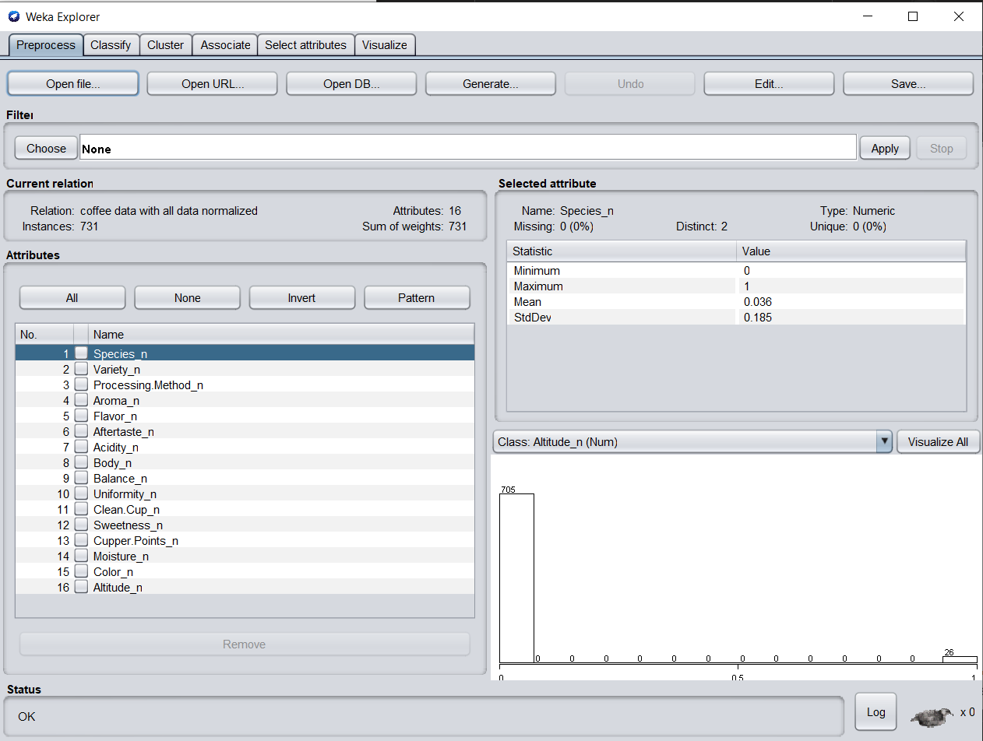
Software Package (Weka)
We load the .csv file into weka and get the following window:

Slide 16
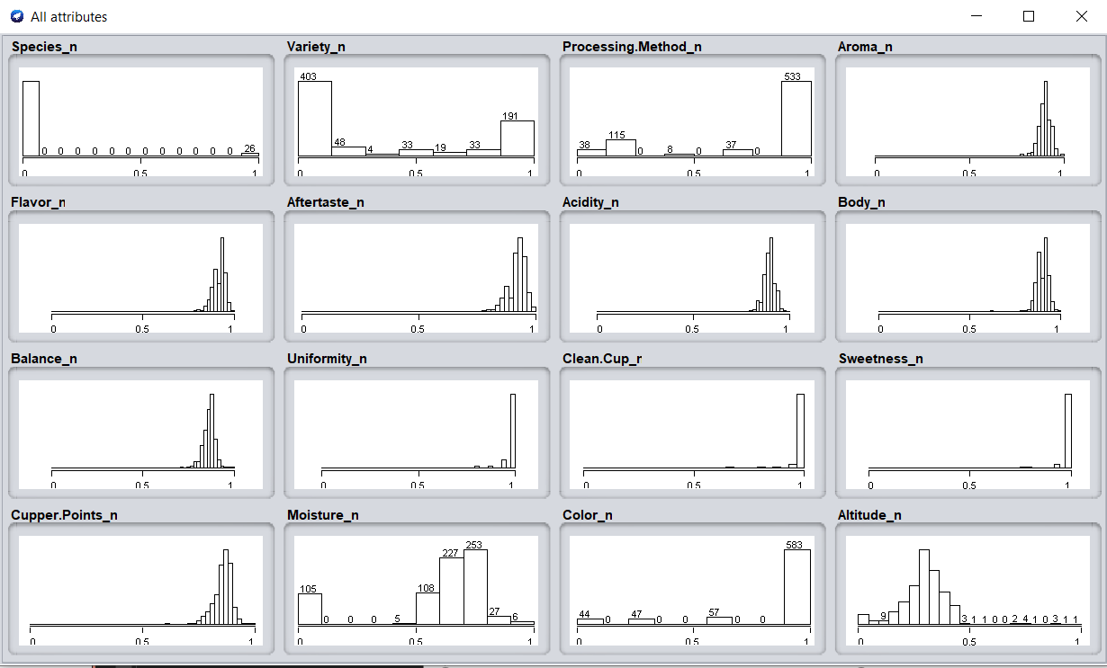
Software Package (Weka)
We can visualize the distribution of the data as follows:

Slide 17
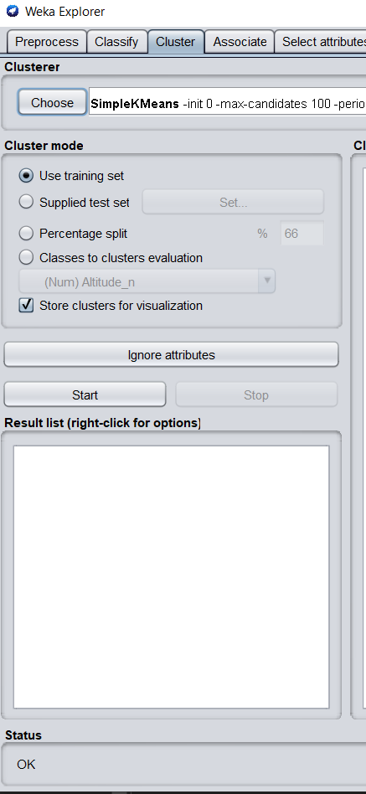
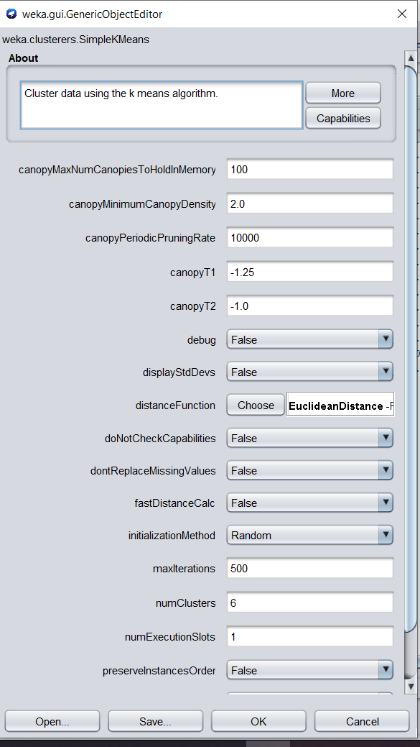
Software Package (Weka)
Before running the algorithm, we the following settings for clustering.

Slide 18
Determination of Number of Clusters
Determining the optimal number of clusters in a data set is a fundamental issue in partitioning clustering, such as k-means clustering, which requires the user to specify the number of clusters k to be generated.
There is no definite answer to this question. However, there are several methods that try to optimize the number of clusters required. We will be using elbow method.
The steps involved in elbow method are:
Compute clustering for different values of k. For instance, by varying k from 1 to 15 clusters.
For each k, calculate the total cluster sum of square error (SSE).
Plot the curve of SSE according to the number of clusters k.
The location of a bend (knee) in the plot is generally considered as an indicator of the appropriate number of clusters.
[4]

Slide 19
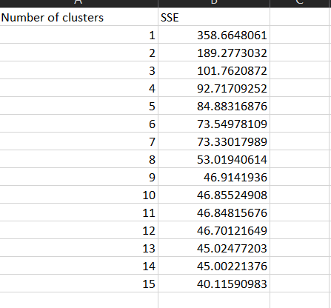
Determination of Number of Clusters
Therefore, we run the algorithm 15 times, varying the number of clusters from 1 to 15. We noted the SSE each time and gather the following data:

Slide 20
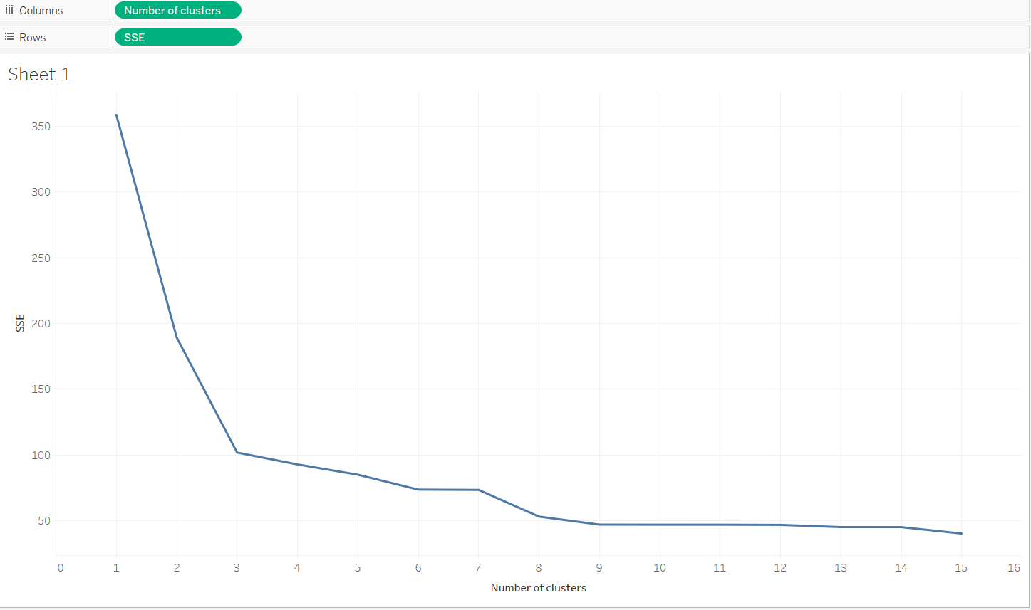
Determination of Number of Clusters
[5]
We plot the data using Tableau.

Slide 21
Determination of Number of Clusters
As we can see, there isn’t a significant drop in SSE after 6 number of clusters.
Therefore, we keep the number of clusters to 6 for our clustering instance.

Slide 22
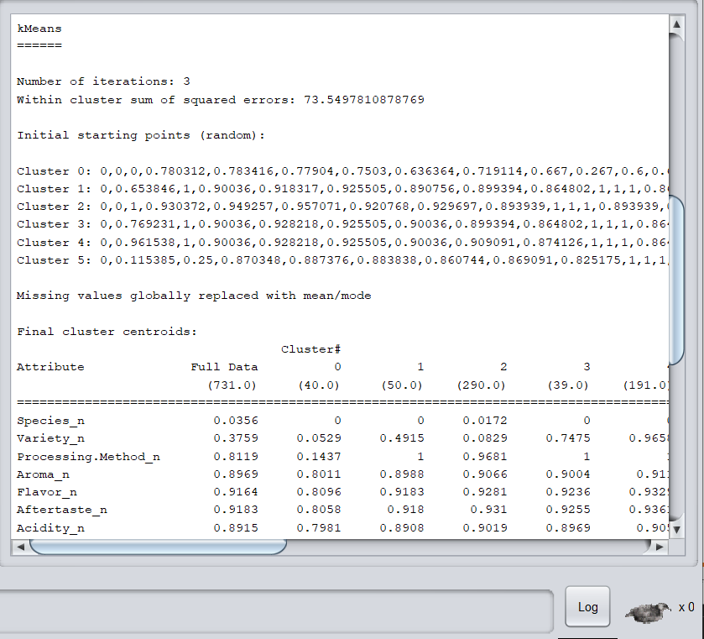
Execution and Analysis
The result of clustering for k=6

Slide 23
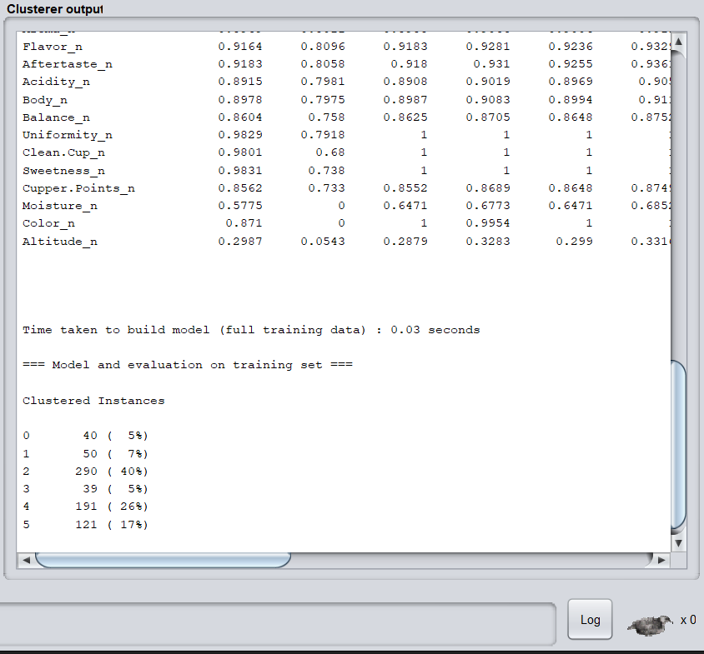
Execution and Analysis

Slide 24
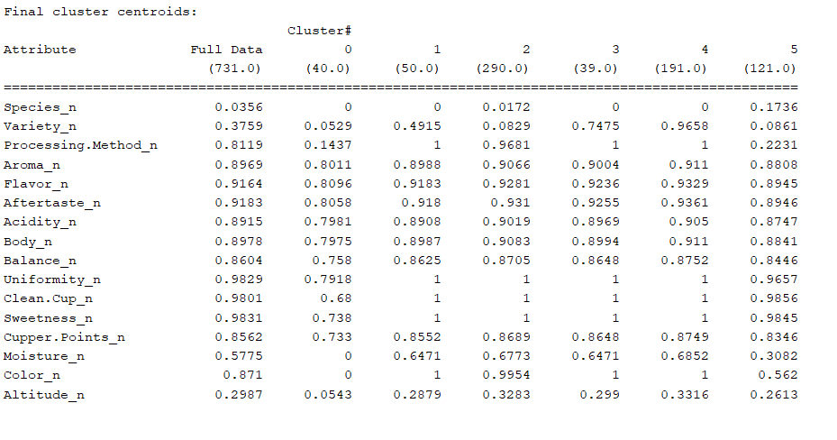
Execution and Analysis
The final cluster centroids were:

Slide 25
Execution and Analysis
Centers of the clusters can be used to characterize the clusters.
These properties are the predominant properties of the coffee beans in a given cluster.
For example:
We can interpret from the clustering result that a coffee bean that is high in Aroma, flavor, aftertaste, acidity, and grows at a higher altitude belongs to cluster 5.
Now, if any customer has bought a coffee bean in the past from this cluster and liked it, we can recommend them a different coffee bean from the same cluster and be confident that the customer will like this recommendation too.
This is how targeted marketing works these days.
This clustering recommendation can be implemented in online websites as well as local coffee shops. The customer gets recommendations on the website online or if they to a local coffee shop regularly, the barista at the coffee shop can access the customers past purchases and recommend a coffee bean accordingly by looking at the other coffee beans in the cluster.

Slide 26
Conclusion
In this task, we have successfully collected data, understood it, prepared it, normalized it and removed the anomalies.
We have determined the optimal number of clusters and clustered the data accordingly.
Upon successful clustering, we get 6 clusters with 6 centroids. These centroids characterize the clusters and all the coffee beans in these clusters have properties like the coffee bean which is the centroid.
The same method can be used in various other domains such as movie recommendation, snacks recommendation, clothing recommendation, electronics recommendation, etc.
Clustering is very powerful because it can be used with the customers data for targeted personalized marketing.
Clustering is used in most online websites such as amazon, Netflix, spotify, google, hulu, steam etc. to make personalized recommendations.
These recommendations in-turn generate revenue.
Therefore, a lot of money is invested by these giants on these unsupervised machine learning algorithms to make sure they're always on the top of their competition.

Slide 27
References
Data source: https://www.kaggle.com/volpatto/coffee-quality-database-from-cqi?select=merged_data_cleaned.csv
[1] https://www.youtube.com/watch?v=rpM3YW_hSaM
[2] https://en.wikipedia.org/wiki/K-means_clustering
[3] https://www.cs.waikato.ac.nz/ml/weka/
[4] https://www.datanovia.com/en/lessons/determining-the-optimal-number-of-clusters-
3-must-know-methods/#gap-statistic-method
[5] https://public.tableau.com/en-us/s/

